Slide 1
Current Result for CI Algorithm
23rd May

Slide 2
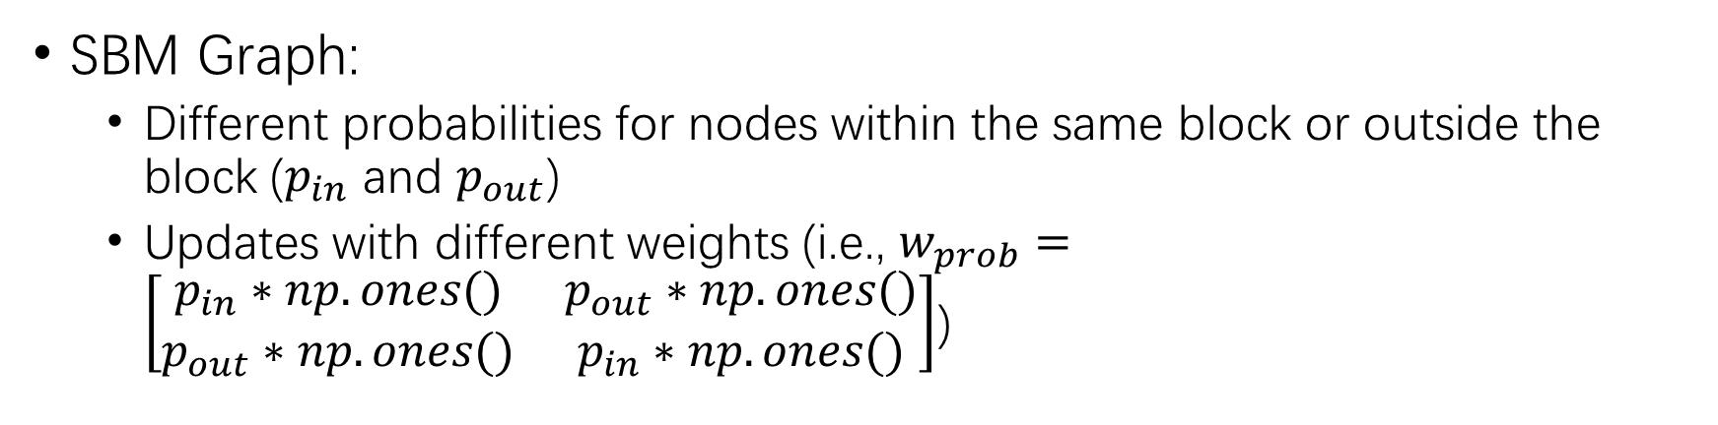
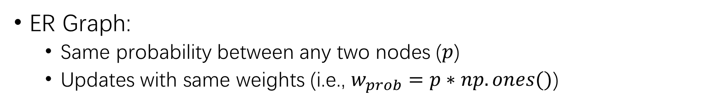
Erdos-Renyi (ER) Graph & SBM Graph
ER Graph:
Same probability between any two nodes ($p$)
Updates with same weights (i.e., $w_{prob}=p∗np.ones()$)
SBM Graph:
Different probabilities for nodes within the same block or outside the block ($p_{in}$ and $p_{out}$)
Updates with different weights (i.e., $w_{prob}=\left[\begin{matrix}p_{in}∗np.ones() & p_{out}∗np.ones() \\ p_{out}∗np.ones() & p_{in}∗np.ones()\end{matrix}\right]$)

Slide 3
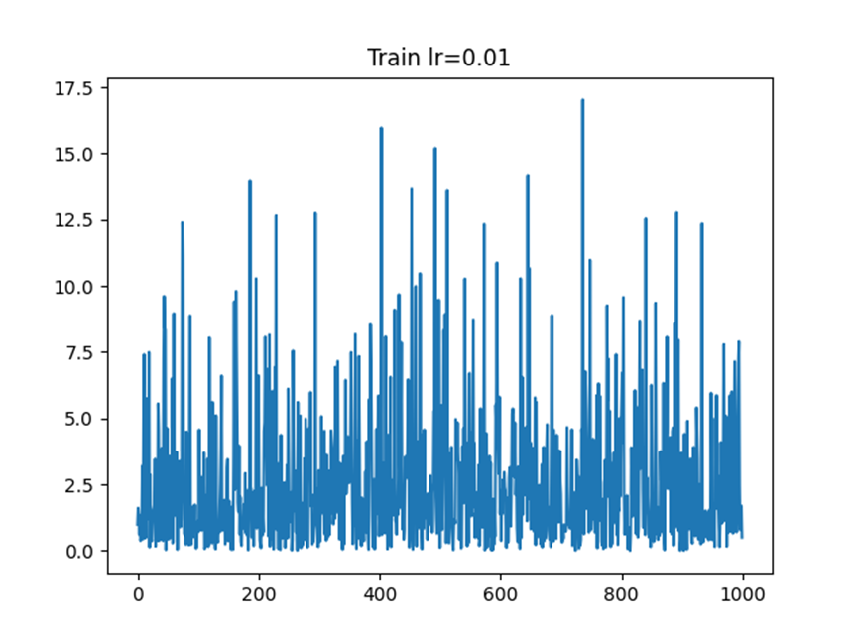
Does not Involve Weights on SBM Graphs

Slide 4
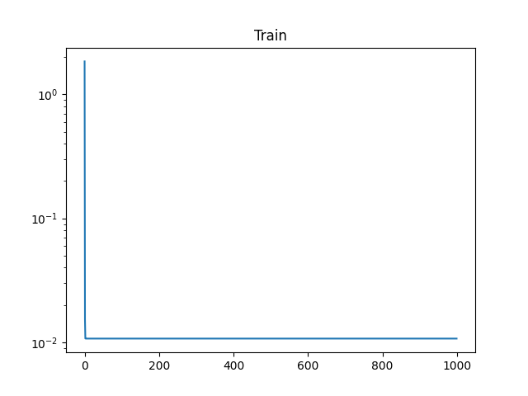
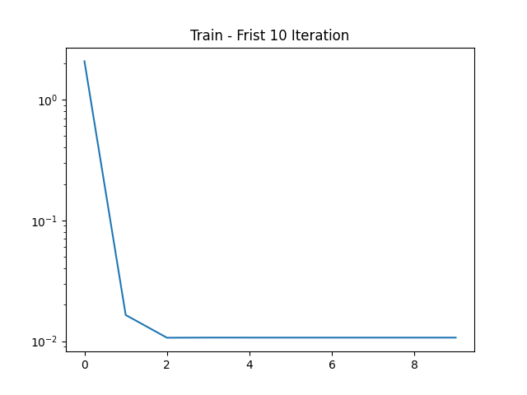
Training Results

Slide 5
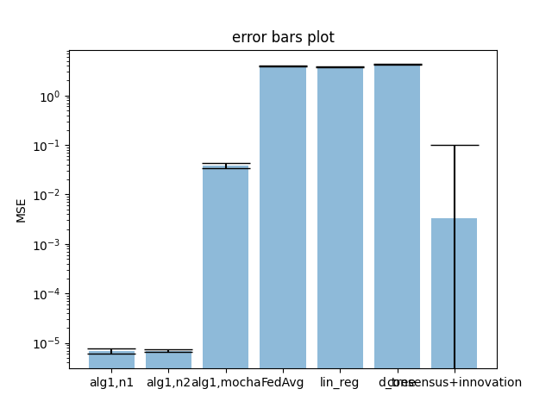
Training Results
Metric | Train | Test
Mean MSE | 0.0031204291182113874 | 0.0030866088207550345
Standard Deviation MSE | 0.0893972589581787 | 0.08581379839236227

Slide 6
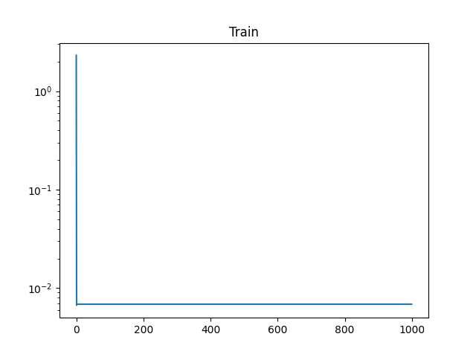

SAGA + CI Results

Slide 7
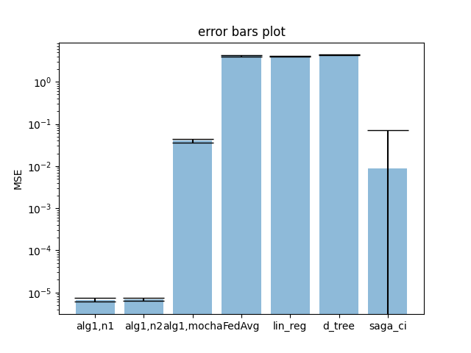
SAGA + CI Results
Metric | Train | Test
Mean MSE | 0.008607971213276822 | 0.007427372147709668
Standard Deviation MSE | 0.08357618501694165 | 0.05576489579547218

Slide 8
Compare CI and SAGA CI
Method | Dataset | Mean MSE | Standard Deviation MSE
CI | Train | 0.0031204291182113874 | 0.0893972589581787
CI | Test | 0.0030866088207550345 | 0.08581379839236227
SAGA CI | Train | 0.008607971213276822 | 0.08357618501694165
SAGA CI | Test | 0.007427372147709668 | 0.05576489579547218

